Slide 1
Preliminary results
Group 24, Bulgarian
Block C Year 2 2024-2025

Slide 2
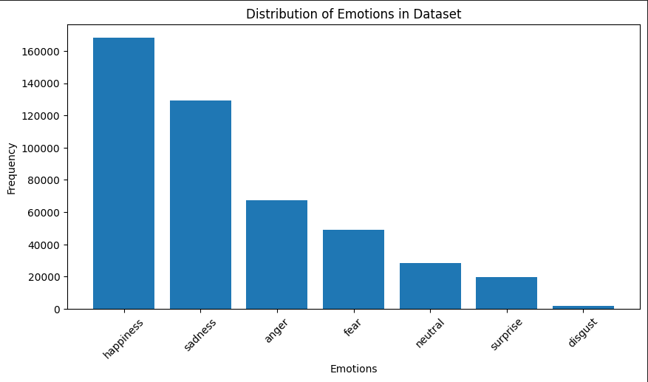
Data
Combined 3 datasets – GoEmotions, MELD, Career
Data Points - 460k
7 core emotions
Features extracted – POS Tags,
Sentiment Scores, Embeddings,
Tokens
Test dataset – low budget drama
Train/Val/Test split – 0.79/0.19/0.02

Slide 3
Methodology
Models Used
Naïve Bayes
Logistic regression
LSTM
RNN
Transformers
Pipeline
Data Import & Cleaning
Feature Extraction- Embeddings, Pos tags, Sentiment Score
Model Training
Evaluation (F1, confusion matrix, error analysis)

Slide 4
Preliminary Results
Model | Validation f1 | Test f1
Naïve Bayes |  | 0.408
Logistic Regression |  | 0.520
LSTM | 0.879 | 0.302
RNN | 0.751 | 0.352
Transformers | 0.81 | 0.4

Slide 5
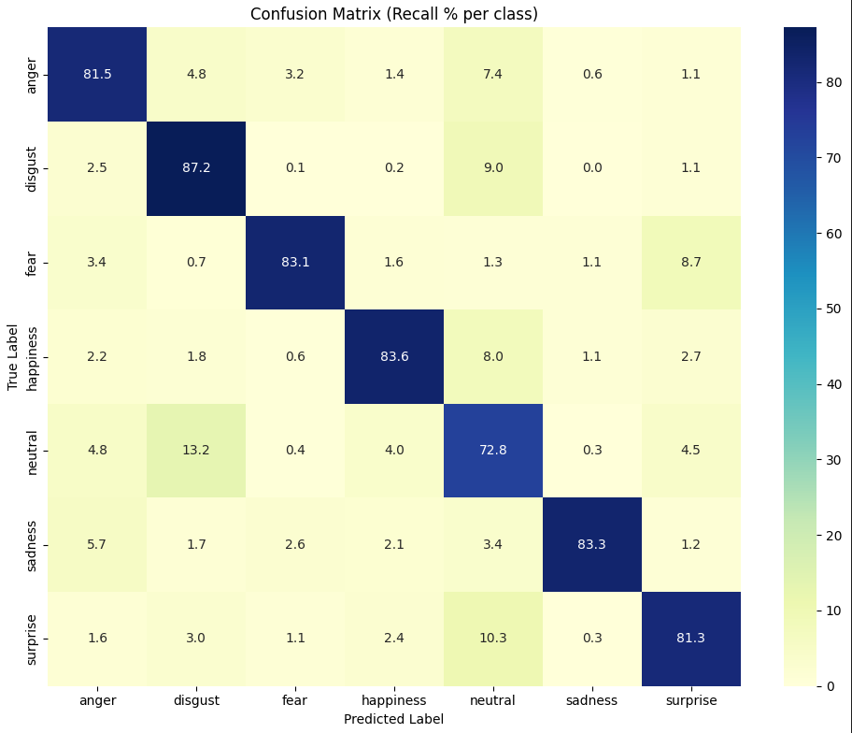
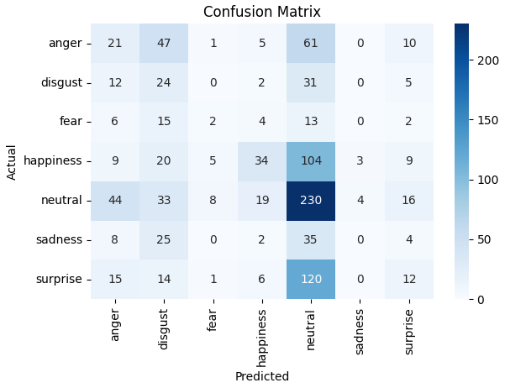
Preliminary Results
Evaluation on Validation Set
Evaluation on Test Set​

Slide 6




Challenges and Limitations
Data Challenges
Imbalanced classes
Technical Challenges
Overfitting
Project Time
Impact on company
Incorrect translation

Slide 7
Next Steps
Upcoming 1-2 weeks
Refining models
Error analysis
Prompt Engineering
Improvements
Adjust class weights
Improve annotations
Making a new dataset - every groups' test set

Slide 8
Thank you

